Slide 5
HIV Pharmaceutical Care in NZ
Dr Charon Lessing

Slide 6
Study Advisory Group:
Funding:

Slide 7
What is Pharmaceutical Care?
“… the attitudes, behaviours, commitments, concerns, ethics, functions, knowledge, responsibilities and skills of the pharmacist
[..] with the goal of achieving definite therapeutic outcomes toward patient health and quality of life.”
Hepler, CD, Strand LM. Am J. Hosp Pharm, 1990; 47: 533-543.

Slide 8
Why do this study?
70% of ⁺adults use one pharmacy only for HIV medicines
ave 6 ‘non-HIV meds’/year/person
most commonly use 3 pharmacies
range 1 to 20+

Slide 9
Why is this ?
14 women & 13 men
throughout Te Ika a Maui and Te Wai Pounamu

Slide 10
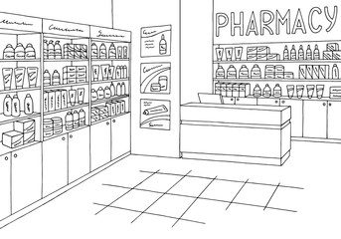
And?
few have navigated to a different pharmacy
directed to first pharmacy
few are comfortable using a single pharmacy for all needs
for women - added dynamics of children and family life
for men - added assumption of being gay
preference for ‘transactional’ pharmacy
courier
variations in dispensing
proactive vs demand

Slide 11
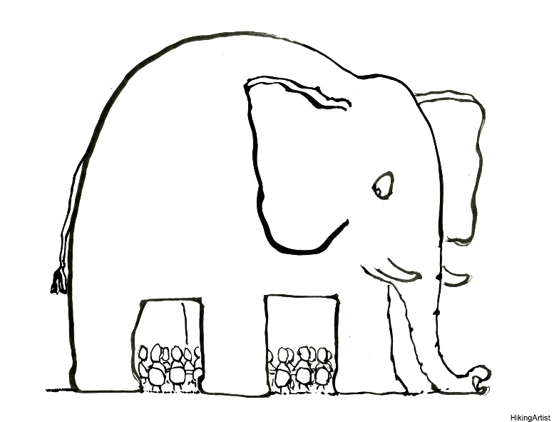
Potential ‘loss’
mismatch: a ‘family’ or ‘local’ pharmacy
transactional / professional
who is (the pharmacist) in the room?
developing a relationship
with the medicines
with the pharmacist
generally v. few negative experiences
“because you don’t have to touch us”

Slide 12
Potential ‘loss’
pharmacy databases not explicitly linked
20 per year - $$ implications
interaction checker – safety implications
alternative therapies
3 month supply (exemption)

Slide 13
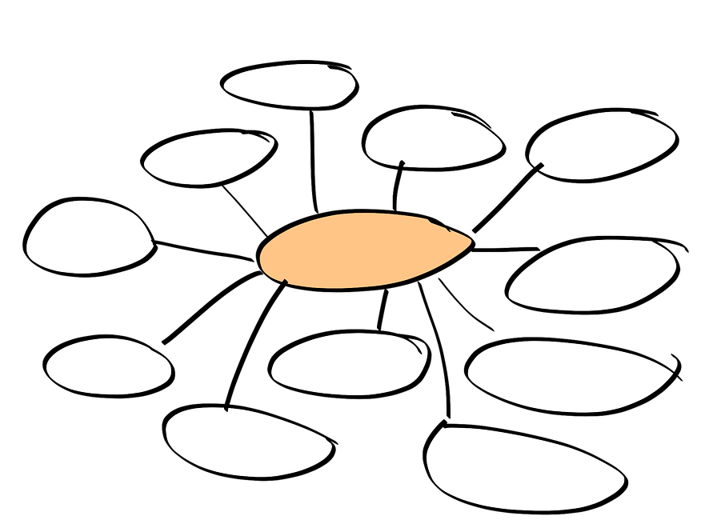
Broader Themes
stigma comes in many forms
power imbalance
breaches of privacy

Slide 14
Way forward
Korero with Study Advisory Group+
Feedback to pharmacy sector
certification? (informal/formal)
Implications for PrEP
Wider implications regarding culture/difference

